Slide 1

Neural Network Models for Object Recognition Using CIFAR-10
Developing a Convolutional Neural Network in Python
Presented by: Md Aminur Rahman
Date: 12/10/2024
Notes:
.

Slide 2
We will:
Load and preprocess the CIFAR-10 dataset.
Partition the dataset into training, validation, and test sets.
Build a CNN model architecture.
Compile the model with appropriate loss function and optimizer.
Train the model with training and validation data.
Evaluate the model on the test data.
Visualize the results and reflect on the learnings.
Project Overview

Slide 3
Understanding Object Recognition
Significance in AI and real-world applications.
Autonomous vehicles
Facial recognition (e.g., smartphones)
Security surveillance
Challenges due to variations in scale, lighting, and orientation.

Slide 4

CIFAR-10 Dataset Overview
About CIFAR-10
Composed of 60,000 color images (32x32 pixels).
10 classes with 6,000 images each.
Airplane, Automobile, Bird, Cat, Deer, Dog, Frog, Horse, Ship, Truck.
Created by Alex Krizhevsky, Vinod Nair, and Geoffrey Hinton.

Slide 5

Data Partitioning
Creating Training, Validation, and Test Sets
Training Set: 80% of the data.
Validation Set: 10% (split from training data).
Test Set: 10% (provided separately).
Methodology:
Used train_test_split from Scikit-learn.
Ensured random and unbiased sampling.

Slide 6
Importance of a Validation Set
Preventing Overfitting
Overfitting: Model performs well on training data but poorly on new data.
Validation set aids in:
Hyperparameter tuning.
Early stopping decisions.
Model selection.

Slide 7
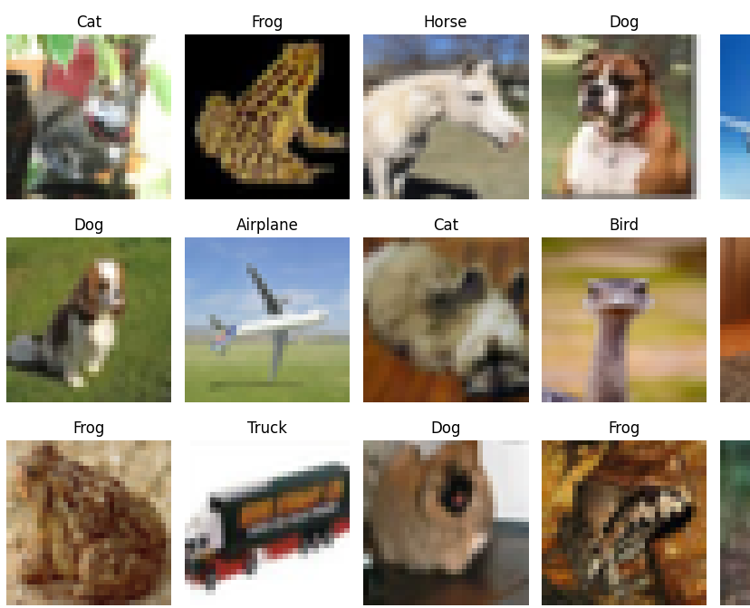
Exploring the Data
Visualizing CIFAR-10 Samples

Slide 8

Neural Network Architecture
Designing the CNN Model
Convolutional Layers:
Extract spatial features.
Three blocks with increasing filters (32, 64, 128).
Pooling Layers:
Max Pooling to reduce dimensionality.
Fully Connected Layers:
Flattening followed by dense layers.
Output Layer:
Dense layer with Softmax activation for classification.

Slide 9
Activation Functions
Choosing ReLU and Softmax
ReLU (Rectified Linear Unit):
Applied to hidden layers.
Introduces non-linearity.
Prevents vanishing gradient problem.
Softmax:
Used in the output layer.
Converts logits to probabilities.

Slide 10

Loss Function and Optimizer
Training the Model
Loss Function: Categorical Cross-Entropy.
Optimizer: Adam optimizer with a learning rate of 0.001.
Metrics: Accuracy.

Slide 11
Training Strategy
Setting Epochs and Batch Size
Epochs: Set to 100 with early stopping.
Batch Size: 64.
Callbacks:
EarlyStopping to monitor validation loss.
Restoring best weights.

Slide 12
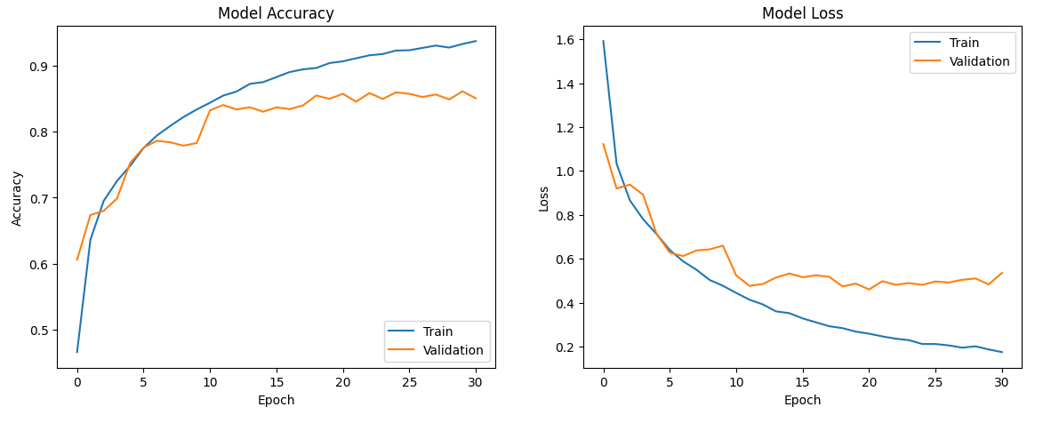
Model Training Results
Accuracy and Loss Graphs

Slide 13
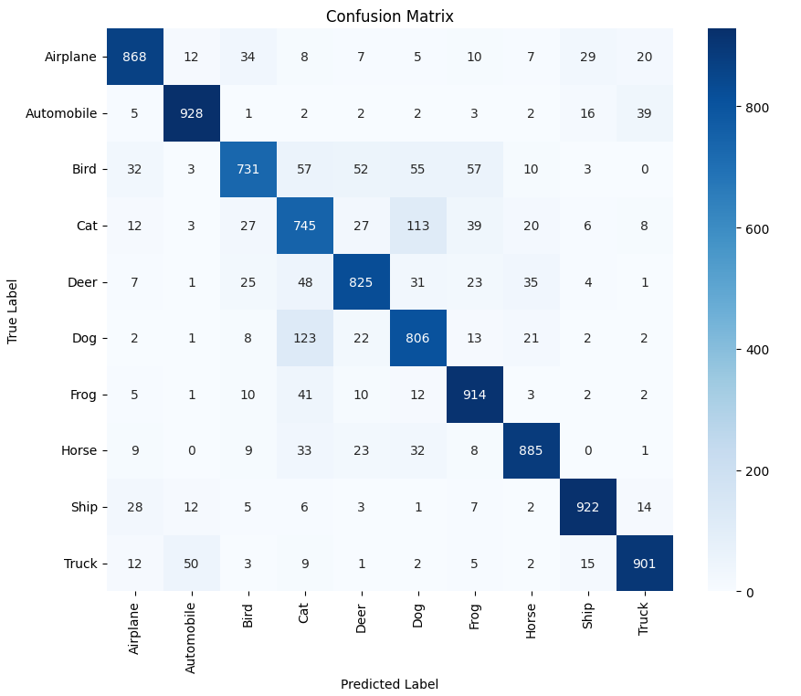
Model Evaluation
Test Set Performance
Test Accuracy: Approximately 80%.
Confusion Matrix:
Visual representation of true vs. predicted labels.

Slide 14
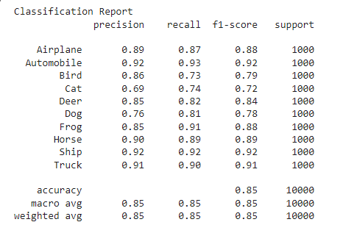
Classification Report
Detailed Metrics
Precision, Recall, F1-Score for each class.
Highlight classes with the highest and lowest scores.

Slide 15
Reflections on the Process
Challenges and Learnings
Challenges:
Dealing with low-resolution images.
Preventing overfitting.
Learnings:
Importance of data preprocessing.
Effectiveness of regularization techniques.
Impact of hyperparameter tuning.

Slide 16
Potential Improvements
Future Work
Data Augmentation:
Techniques like rotation, flipping, and zooming.
Advanced Architectures:
Exploring ResNet, DenseNet models.
Hyperparameter Optimization:
Using tools like Grid Search or Random Search.
Ensemble Methods:
Combining multiple models for better performance.

Slide 17
Conclusion
Key Takeaways
Successfully built a CNN for object recognition with CIFAR-10.
Achieved a test accuracy of ~80%.
Gained practical experience in deep learning and model evaluation.
Recognized the importance of proper data handling and model tuning.

Slide 18
References
Bergstra, J. and Bengio, Y., 2012. Random search for hyper-parameter optimization. Journal of Machine Learning Research, 13, pp.281-305.
Bishop, C.M., 2006. Pattern Recognition and Machine Learning. New York: Springer.
Chollet, F., 2015. Keras Documentation. [online] Available at: https://keras.io [Accessed 25 September 2024].
Dietterich, T.G., 2000. Ensemble methods in machine learning. In: International Workshop on Multiple Classifier Systems. Berlin, Heidelberg: Springer, pp.1-15.
Goodfellow, I., Bengio, Y. and Courville, A., 2016. Deep Learning. Cambridge, MA: MIT Press.
He, K., Zhang, X., Ren, S. and Sun, J., 2016. Deep residual learning for image recognition. In: Proceedings of the IEEE Conference on Computer Vision and Pattern Recognition (CVPR), Las Vegas, NV, 27-30 June 2016, pp.770-778.
Huang, G., Liu, Z., Van Der Maaten, L. and Weinberger, K.Q., 2017. Densely connected convolutional networks. In: Proceedings of the IEEE Conference on Computer Vision and Pattern Recognition (CVPR), Honolulu, HI, 21-26 July 2017, pp.4700-4708.
Kingma, D.P. and Ba, J., 2014. Adam: A method for stochastic optimization. arXiv preprint arXiv:1412.6980. [online] Available at: https://arxiv.org/abs/1412.6980 [Accessed 25 September 2024].

Slide 19
Krizhevsky, A., Sutskever, I. and Hinton, G.E., 2012. ImageNet classification with deep convolutional neural networks. In: Advances in Neural Information Processing Systems (NIPS), Lake Tahoe, NV, 3-8 December 2012, pp.1097-1105.
Krizhevsky, A., Nair, V. and Hinton, G., 2009. CIFAR-10 Dataset. [online] Available at: https://www.cs.toronto.edu/~kriz/cifar.html [Accessed 25 September 2024].
LeCun, Y., Bottou, L., Bengio, Y. and Haffner, P., 1998. Gradient-based learning applied to document recognition. Proceedings of the IEEE, 86(11), pp.2278-2324.
Murphy, K.P., 2012. Machine Learning: A Probabilistic Perspective. Cambridge, MA: MIT Press.
Prechelt, L., 1998. Early stopping—But when?. In: G. Orr and K.-R. Müller, eds. 1998. Neural Networks: Tricks of the Trade. Berlin: Springer, pp.55-69.
Sokolova, M. and Lapalme, G., 2009. A systematic analysis of performance measures for classification tasks. Information Processing & Management, 45(4), pp.427-437.
Srivastava, N., Hinton, G., Krizhevsky, A., Sutskever, I. and Salakhutdinov, R., 2014. Dropout: A simple way to prevent neural networks from overfitting. Journal of Machine Learning Research, 15(1), pp.1929-1958.
Wilson, A.C., Roelofs, R., Stern, M., Srebro, N. and Recht, B., 2017. The marginal value of adaptive gradient methods in machine learning. In: Advances in Neural Information Processing Systems (NIPS), Long Beach, CA, 4-9 December 2017, pp.4148-4158.

Slide 20
Appendixes:
Import The Data Set and libraries
import numpy as np
import matplotlib.pyplot as plt
import seaborn as sns
from tensorflow.keras.datasets import cifar10
from tensorflow.keras.utils import to_categorical
from tensorflow.keras.models import Sequential
from tensorflow.keras.layers import (Conv2D, MaxPooling2D, Flatten,
Dense, Dropout, BatchNormalization)
from tensorflow.keras.optimizers import Adam
from tensorflow.keras.callbacks import EarlyStopping
from sklearn.model_selection import train_test_split
from sklearn.metrics import confusion_matrix, classification_report
2. Load and Process the CIFAR-10 Dataset
# Load the CIFAR-10 dataset
(x_train_full, y_train_full), (x_test, y_test) = cifar10.load_data()
# Normalize pixel values to be between 0 and 1
x_train_full = x_train_full.astype('float32') / 255.0
x_test = x_test.astype('float32') / 255.0
# One-hot encode the labels
y_train_full = to_categorical(y_train_full, 10)
y_test = to_categorical(y_test, 10)

Slide 21
3. Partition Validation Set from Training Data
# Split the training data to create a validation set (10% of training data)
x_train, x_val, y_train, y_val = train_test_split(
x_train_full, y_train_full, test_size=0.1, random_state=42)
print(f'Training set size: {x_train.shape[0]} samples')
print(f'Validation set size: {x_val.shape[0]} samples')
print(f'Test set size: {x_test.shape[0]} samples')
4. Explore the Data
# Define class names for CIFAR-10
class_names = ['Airplane', 'Automobile', 'Bird', 'Cat', 'Deer',
'Dog', 'Frog', 'Horse', 'Ship', 'Truck']
# Display sample images from the training set
fig, axes = plt.subplots(3, 5, figsize=(10, 7))
axes = axes.ravel()
for i in range(15):
idx = np.random.randint(0, len(x_train))
axes[i].imshow(x_train[idx])
axes[i].set_title(class_names[np.argmax(y_train[idx])])
axes[i].axis('off')
plt.tight_layout()
plt.show()

Slide 22
5. Build the CNN Model
# Convolutional Layer Block 1
model.add(Conv2D(32, (3, 3), padding='same', activation='relu',
input_shape=(32, 32, 3)))
model.add(BatchNormalization())
model.add(Conv2D(32, (3, 3), activation='relu', padding='same'))
model.add(BatchNormalization())
model.add(MaxPooling2D((2, 2)))
model.add(Dropout(0.25))
# Convolutional Layer Block 2
model.add(Conv2D(64, (3, 3), activation='relu', padding='same'))
model.add(BatchNormalization())
model.add(Conv2D(64, (3, 3), activation='relu', padding='same'))
model.add(BatchNormalization())
model.add(MaxPooling2D((2, 2)))
model.add(Dropout(0.25))
# Convolutional Layer Block 3
model.add(Conv2D(128, (3, 3), activation='relu', padding='same'))
model.add(BatchNormalization())
model.add(Conv2D(128, (3, 3), activation='relu', padding='same'))
model.add(BatchNormalization())
model.add(MaxPooling2D((2, 2)))
model.add(Dropout(0.25))
# Fully Connected Layers
model.add(Flatten())
model.add(Dense(512, activation='relu'))
model.add(BatchNormalization())
model.add(Dropout(0.5))
model.add(Dense(10, activation='softmax'))
# Display the model's architecture
model.summary()

Slide 23
6. Compile the Model
model.compile(optimizer=Adam(learning_rate=0.001),
loss='categorical_crossentropy',
metrics=['accuracy'])
7. Define Callbacks
# Early stopping to prevent overfitting
early_stopping = EarlyStopping(monitor='val_loss',
patience=10,
restore_best_weights=True)
8. Train the Model
history = model.fit(x_train, y_train,
epochs=100,
batch_size=64,
validation_data=(x_val, y_val),
callbacks=[early_stopping])
9. Evaluate the Model
# Evaluate on the test set
test_loss, test_accuracy = model.evaluate(x_test, y_test)
print(f'Test Accuracy: {test_accuracy:.4f}')

Slide 24
10. Visualize Training History
# Plot training & validation accuracy values
plt.figure(figsize=(14, 5))
plt.subplot(1, 2, 1)
plt.plot(history.history['accuracy'], label='Train')
plt.plot(history.history['val_accuracy'], label='Validation')
plt.title('Model Accuracy')
plt.xlabel('Epoch')
plt.ylabel('Accuracy')
plt.legend(loc='lower right')
# Plot training & validation loss values
plt.subplot(1, 2, 2)
plt.plot(history.history['loss'], label='Train')
plt.plot(history.history['val_loss'], label='Validation')
plt.title('Model Loss')
plt.xlabel('Epoch')
plt.ylabel('Loss')
plt.legend(loc='upper right')
plt.show()

Slide 25
11. Confusion Matrix and Classification Report
# Predict classes for test set
y_pred = model.predict(x_test)
y_pred_classes = np.argmax(y_pred, axis=1)
y_true_classes = np.argmax(y_test, axis=1)
# Compute confusion matrix
conf_matrix = confusion_matrix(y_true_classes, y_pred_classes)
# Plot confusion matrix
plt.figure(figsize=(10, 8))
sns.heatmap(conf_matrix, annot=True, fmt='d',
cmap='Blues', xticklabels=class_names,
yticklabels=class_names)
plt.xlabel('Predicted Label')
plt.ylabel('True Label')
plt.title('Confusion Matrix')
plt.show()
# Print classification report
print('Classification Report')
print(classification_report(y_true_classes, y_pred_classes,
target_names=class_names))

